Slide 1
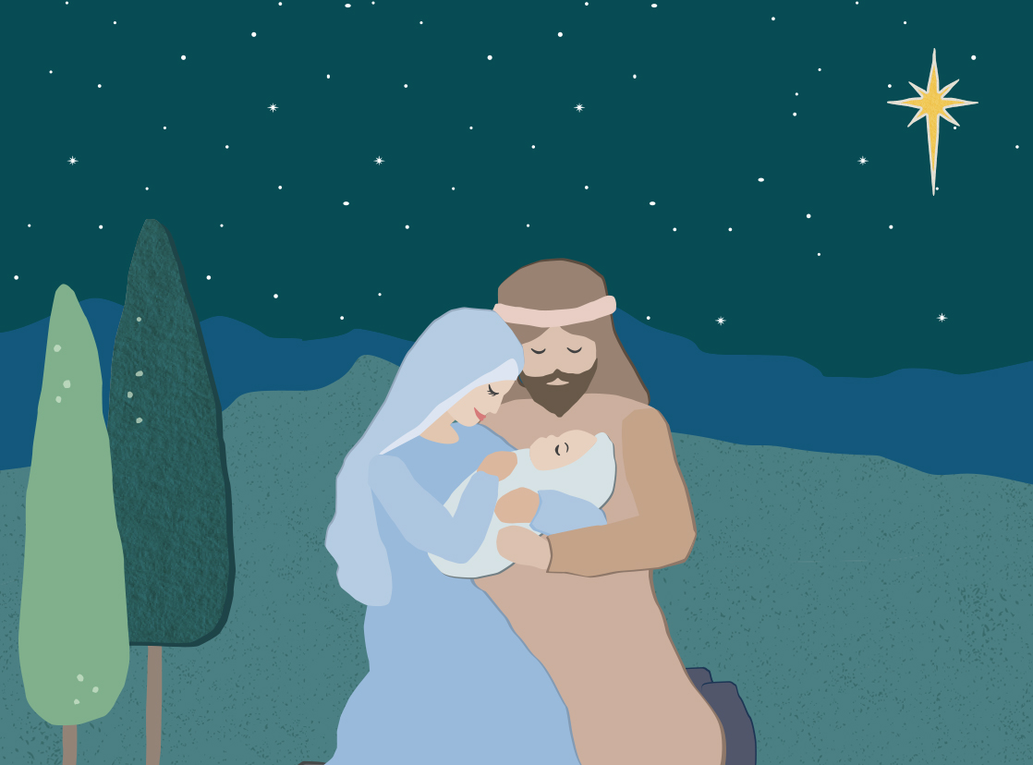
Advent…
preparing our hearts to receive the gift of Jesus at Christmas
^{Secondary schools}

Slide 2
Advent… preparing our hearts to receive the gift of Jesus at Christmas
Structure of the Resource
This resource has been created as an A4 sized landscape PowerPoint so it can be either printed as handouts or shown full screen. Some of the stories may be confronting to students at your school. This resource has been uploaded as an editable file enabling teachers to add in more confronting details or remove as they see fit. The most confronting version of each story is contained in the Notes on the story page.
This resource has been designed to use as a whole class activity throughout Advent or as part of a social justice group meeting.
Each week there are the following components:
A prayer
Gospel Reading
Gospel Reflection
Community Story
Community Reflection
See, Judge, Act
There is also a See, Judge, Act worksheet for students that is included at the end of each weekly section.
^{giftofgoodness.org}

Slide 3
Advent… preparing our hearts to receive the gift of Jesus at Christmas
About Advent
Advent comes from the Latin word meaning "coming." Jesus is coming, and Advent is intended to be a season of preparation for His arrival. While we typically regard Advent as a joyous season, it is also intended to be a period of preparation, much like Lent. Prayer, penance and fasting are appropriate during this season.
Advent is not as strict as Lent, and there are no rules for fasting, but it is meant to be a period of self-preparation. The purple colour associated with Advent is also the colour of penance. The faithful should fast during the first two weeks in particular and receive the Sacrament of Reconciliation.
The colour of the Third Sunday of Advent is rose. This colour symbolises joy and represents the happiness we will experience when Jesus comes again. The Third Sunday is a day of anticipatory celebration. It is formerly called "Gaudete" Sunday; gaudete means "rejoice" in Latin.
Finally, Sundays during Advent, just as during Lent, should not be given to fasting, but instead to celebration because we celebrate the resurrection of Our Lord every Sunday. Source: Catholic online
^{giftofgoodness.org}
Notes:
Qsource: https://www.catholic.org/advent/advent.php?id=5

Slide 4
About CatholicCare
CatholicCare is the social services agency of the Archdiocese of Sydney. Every day we walk in solidarity with individuals, families and communities to realise our vision of a society in which we all feel valued and supported.
Our greatest wish is to see people in our communities thrive.
We strive to realise this vision by providing a broad range of social services built on a mission of valuing dignity, strengthening families and connecting communities.
CatholicCare services help people to live and thrive at every age, irrespective of beliefs and abilities. We help Sydney families with relationships, parenting, ageing, disabilities, addictions and mental health concerns.
^{giftofgoodness.org}
Notes:
Teacher Information:
CatholicCare is the social services agency of the Archdiocese of Sydney. Every day we walk in solidarity with individuals, families and communities to realise our vision of a society in which we all feel valued and supported.
Our greatest wish is to see people in our communities thrive.
We strive to realise this vision by providing a broad range of social services built on a mission of valuing dignity, strengthening families and connecting communities.
CatholicCare services help people to live and thrive at every age, irrespective of beliefs and abilities. We help Sydney families with relationships, parenting, ageing, disabilities, addictions and mental health concerns.

Slide 6
Many Sydney families need extra help at Christmas time.
Some can’t afford even the most basic food items to make a healthy meal, let alone Christmas dinner.
And some need extra assistance because their family is in crisis at Christmas time.
This year the good people at Harris Farm Markets are helping us provide nutritious Christmas Hampers for the many people who call CCareline needing food and help.
Our class can give a Gift of Goodness by collecting money for hampers and by sending messages of love to families facing hardship.
^{giftofgoodness.org}

Slide 7
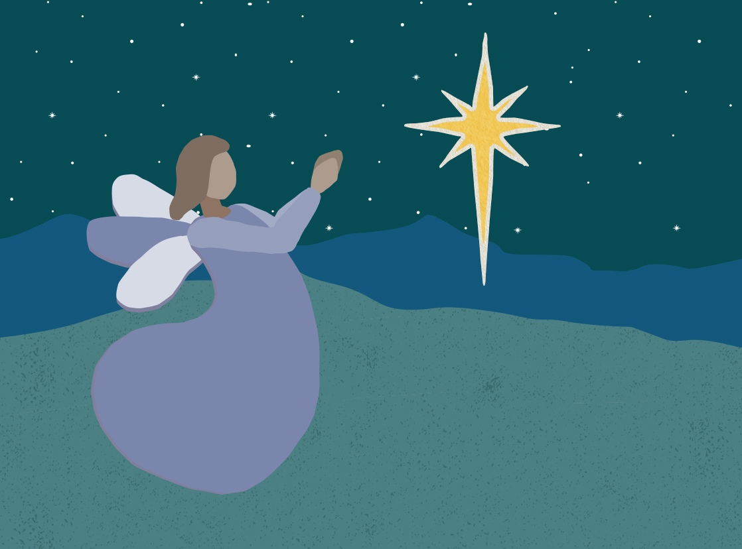
Week One: A Week of Hope
Lord Our God,
You are the source of all. Accompany us this Advent as we prepare for the coming of Jesus. Guide us and lead us Lord as we use our gifts of goodness to work as one to create the world you want.
Awake in my heart hope, peace, love and joy this Advent.
We ask this prayer in Your name,
Amen.

Slide 8
Week One: A Week of Hope
A reading from the holy Gospel according to Luke 21:25-28. 34-36
Jesus said to his disciples: ‘There will be signs in the sun and moon and stars; on earth nations in agony, bewildered by the clamour of the ocean and its waves; men dying of fear as they await what menaces the world, for the powers of heaven will be shaken. And then they will see the Son of Man coming in a cloud with power and great glory. When these things begin to take place, stand erect, hold your heads high, because your liberation is near at hand.
‘Watch yourselves, or your hearts will be coarsened with debauchery and drunkenness and the cares of life, and that day will be sprung on you suddenly, like a trap. For it will come down on every living man on the face of the earth. Stay awake, praying at all times for the strength to survive all that is going to happen, and to stand with confidence before the Son of Man.’
Reflection Questions
Why is Advent the beginning of the Church’s year?
What is a symbol for you of waiting?
What does it mean to ‘stay awake’?
How can we share the spirit of Advent with those around us at school and in Sydney?
When have you waited? How did you feel and what did you do?
What is the difference between pointless waiting and active waiting?
What is your hope for the future?
^{giftofgoodness.org}

Slide 9
Michael: A story of Hope
Michael lives in Sydney and his family have been facing hardships for most of his life. Like Mary, Michael’s mother was pretty young when Michael was born. His dad doesn’t live with them any more.
Michael is quite young and his mother struggled with addiction and mental health issues before she became pregnant with him.
CatholicCare runs an intervention service that works with children, like Michael who are at risk of being taken into care, away from their family.
Michael’s mum has been working with CatholicCare’s HOPE program for three years and is looking to provide a better life for Michael and herself.
Christmas is a time of hope… but it has often been harder at Michael’s house. Last year CatholicCare brought a hamper of food, a gift of goodness to Michael’s family. Michael and his mum were filled with joy and hope.
Michael’s mum has hope. She is working hard and has finished school. She’s is studying to be a social worker and has turned her life around; she wants to help others like her change their lives too. Michael’s mum wants to give hope to babies born into poverty and hardship.
Other people’s kindness gives Michael hope that the future will be brighter. When you support CatholicCare’s Gift of Goodness campaign you are helping families like Michael’s all across Sydney.
^{giftofgoodness.org}
Notes:
CatholicCare runs an intervention service that works with children who are at risk of being taken into foster care owing to parental neglect. There are often instances where young women, themselves from highly disadvantaged backgrounds, have children of their own at a young age. One such woman was Karen. She was an ice user when she found out she was pregnant.
She stopped using immediately and was introduced into the HOPE program. She worked with intensive social working services to help her find housing, look after her health during pregnancy and after, finish her education and learn parenting skills. The HOPE program lasts for three years and works to break the cycle of intergenerational disadvantage. Today Karen is studying to become a social worker herself. She wants to help others like her change their lives and she wants to provide hope to babies born into poverty and hardship.
The HOPE mothers and their children are just some of the people that the CatholicCare Christmas hampers and CatholicCare’s services help.

Slide 10
Reflect
How is Michael’s story one of hope?
Michael and his mum have faced many challenges on her journey. What challenges have you faced?
In 2017 CatholicCare provided family support to thousands of families across our city. Why is it vital that services like this are available to families like Michael’s?
How can you raise awareness of the work of CatholicCare and help to promote the Gift of Goodness campaign this Advent?
How can you use your gifts of goodness this Advent at home, school and across our Catholic family in Sydney?
^{giftofgoodness.org}

Slide 11
See, Judge, Act
See
What exactly is happening?
What is it doing to the people?
Why is this happening?
Judge
What do you think about all this?
What do you think should be happening?
What does your faith say?
Act
What exactly is it that you want to change?
What actions are you going to take now?
Who can you involve in your action?
^{giftofgoodness.org}
Notes:
http://resources.cardijn.info/sja-in-nine-questions

Slide 12
See, Judge, Act Based upon the Cardijn Method
See What exactly is happening? What is it doing to the people? Why is this happening?
Judge What do you think about all this? What do you think should be happening? What does your faith say?
^{giftofgoodness.org}

Slide 13
See, Judge, Act Based upon the Cardijn Method
Act What exactly is it that you want to change? What actions are you going to take now? Who can you involve in your action?
^{giftofgoodness.org}

Slide 15
Week Two: A Week of Peace
Lord Our God,
You are the source of all.
Accompany us this Advent as we prepare for the coming of Jesus. Guide us and lead us Lord as we use our gifts of goodness to work as one to create the world you want.
Awake in my heart hope, peace, love and joy this Advent.
We ask this prayer in Your name,
Amen.
^{giftofgoodness.org}

Slide 16
Week Two: A Week of Peace
A reading from the holy Gospel according to Luke 3:1-6
In the fifteenth year of Tiberius Caesar’s reign, when Pontius Pilate was governor of Judaea, Herod tetrarch of Galilee, his brother Philip tetrarch of the lands of Ituraea and Trachonitis, Lysanias tetrarch of Abilene, during the pontificate of Annas and Caiaphas, the word of God came to John son of Zechariah, in the wilderness. He went through the whole Jordan district proclaiming a baptism of repentance for the forgiveness of sins, as it is written in the book of the sayings of the prophet Isaiah:
A voice cries in the wilderness; Prepare a way for the Lord, make his paths straight. Every valley will be filled in, every mountain and hill be laid low, winding ways will be straightened and rough roads made smooth. And all mankind shall see the salvation of God.
Reflection Questions
How are you tuning into God this Advent?
How can you prepare a way for the Lord?
How does the Lord make your path straight?
Water springs new life and is a symbol of rebirth. In what ways is this relevant and important to us this Advent?
If Jesus was walking among us do you think we would notice, or are we too self absorbed?
What changes are you making this Advent?
^{giftofgoodness.org}

Slide 17
The Nin Family: A Story of Peace
Have you traveled and spent much time overseas? Do you have family and friends who have moved to Australia from another country? When we travel and speak with people who have experienced life in a different country there is always so much to learn about the culture and practices of our family around the world.
We can easily forget that some of the practices and expectations we have here in Australia are not the norm overseas. Recently CatholicCare became involved with a family from Burundi, a country in West Africa. There are five children in the family that range from 18 years of age to just three.
In Burundi there are cultural practices that are considered normal, like physical discipline, that are not accepted here in Australia. Because they inadvertently broke our society’s rules and norms the family was at risk of being separated and the children taken into care.
Moreover, the parents didn’t understand the Australian school system and, as a result, didn’t always encourage their children to go to school.
CatholicCare’s Cultural Assist program worked to better understand the family’s culture and blend it with our Australian culture.
Working with someone who knew the culture meant CatholicCare could better engage with the family. They were able to work together to improve the home situation and the family’s relationship with the school. Through this program, the children learnt to respect their parents’ culture. They are much happier now and living a peaceful life here in Australia.
Notes:
Teachers may add in more confronting details or remove as they see fit.
We had a family referred to us from FaCS, who had come from Burundi, which is a county in East Africa. They were at high risk of losing their five children aged 15, 13, 8, 5 and 3. In Burundi they have different cultures and customs that we don’t follow in Australia, such as punishing children through violence.
The parents didn’t understand the Australian school system and, as a result, didn’t always encourage their children to go to school. At CatholicCare we have a program called Cultural Assist, which helped me as the caseworker better understand the family’s culture and blend it with our Australian culture. I worked with a buddy who knew the Burundi language, culture and customs who was a social work student from Western Sydney University.
Working with someone who knew the culture meant we could better engage with the family. By being able to engage with the family we were able to work together to improve the home situation and the family’s relationship with the school. Through this program, the children learnt to respect their parents’ culture. The family improved their standard of living, the parents learnt better parenting strategies and the children were able to remain living with their parents.

Slide 18
Reflection
How is this a story of peace?
Why is it important that CatholicCare works with people who understand the language and culture of families in the Cultural Assist program?
How can you help people in Australia who are having trouble understanding the language or what is expected of them?
What is my message of peace as we wait for the birth of Jesus?
How does my support of the Gifts of Goodness campaign make a difference in the lives of others?
^{giftofgoodness.org}

Slide 19
See, Judge, Act
See
What exactly is happening?
What is it doing to the people?
Why is this happening?
Judge
What do you think about all this?
What do you think should be happening?
What does your faith say?
Act
What exactly is it that you want to change?
What actions are you going to take now?
Who can you involve in your action?
^{giftofgoodness.org}
Notes:
http://resources.cardijn.info/sja-in-nine-questions

Slide 20
See, Judge, Act Based upon the Cardijn Method
See What exactly is happening? What is it doing to the people? Why is this happening?
Judge What do you think about all this? What do you think should be happening? What does your faith say?
^{giftofgoodness.org}

Slide 21
See, Judge, Act Based upon the Cardijn Method
Act What exactly is it that you want to change? What actions are you going to take now? Who can you involve in your action?
^{giftofgoodness.org}

Slide 23
Lord Our God,
You are the source of all.
Accompany us this Advent as we prepare for the coming of Jesus. Guide us and lead us Lord as we use our gifts of goodness to work as one to create the world you want.
Awake in my heart hope, peace, love and joy this Advent.
We ask this prayer in Your name,
Amen.
Week Three: A Week of Joy
Notes:
Notes for Teachers:
It is recommended that the Word is read directly from the Bible.
A copy of the scriptural text is included below for your reference taken from
Lk 3:10-18
A reading from the holy Gospel according to Luke
What, then, must we do?
When all the people asked John, ‘What must we do?’ he answered, ‘If anyone has two tunics he must share with the man who has none, and the one with something to eat must do the same.’ There were tax collectors too who came for baptism, and these said to him, ‘Master, what must we do?’ He said to them, ‘Exact no more than your rate.’ Some soldiers asked him in their turn, ‘What about us? What must we do?’ He said to them, ‘No intimidation! No extortion! Be content with your pay!’
A feeling of expectancy had grown among the people, who were beginning to think that John might be the Christ, so John declared before them all, ‘I baptise you with water, but someone is coming, someone who is more powerful than I am, and I am not fit to undo the strap of his sandals; he will baptise you with the Holy Spirit and fire. His winnowing-fan is in his hand to clear his threshing-floor and to gather the wheat into his barn; but the chaff he will burn in a fire that will never go out.’ As well as this, there were many other things he said to exhort the people and to announce the Good News to them.

Slide 24
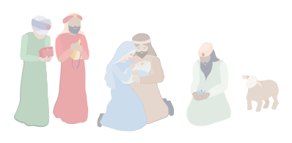
Week Three: A Week of Joy
A reading from the holy Gospel according to Luke 3:10-18
What, then, must we do?
When all the people asked John, ‘What must we do?’ he answered, ‘If anyone has two tunics he must share with the man who has none, and the one with something to eat must do the same.’ There were tax collectors too who came for baptism, and these said to him, ‘Master, what must we do?’ He said to them, ‘Exact no more than your rate.’ Some soldiers asked him in their turn, ‘What about us? What must we do?’ He said to them, ‘No intimidation! No extortion! Be content with your pay!’
A feeling of expectancy had grown among the people, who were beginning to think that John might be the Christ, so John declared before them all, ‘I baptise you with water, but someone is coming, someone who is more powerful than I am, and I am not fit to undo the strap of his sandals; he will baptise you with the Holy Spirit and fire. His winnowing-fan is in his hand to clear his threshing-floor and to gather the wheat into his barn; but the chaff he will burn in a fire that will never go out.’ As well as this, there were many other things he said to exhort the people and to announce the Good News to them.
Reflection Questions
Why do you think the people were beginning to think that John was the Messiah?
What is the symbolism behind the use of fire and water?
Where do we see the use of fire and water in our life in the Church?
How do we experience the closeness of God through our interactions with one another?
Are there changes you need to make in your life to show you are the Good News?
^{giftofgoodness.org}
Notes:
Notes for Teachers:
It is recommended that the Word is read directly from the Bible.
A copy of the scriptural text is included below for your reference taken from
Lk 3:10-18
A reading from the holy Gospel according to Luke
What, then, must we do?
When all the people asked John, ‘What must we do?’ he answered, ‘If anyone has two tunics he must share with the man who has none, and the one with something to eat must do the same.’ There were tax collectors too who came for baptism, and these said to him, ‘Master, what must we do?’ He said to them, ‘Exact no more than your rate.’ Some soldiers asked him in their turn, ‘What about us? What must we do?’ He said to them, ‘No intimidation! No extortion! Be content with your pay!’
A feeling of expectancy had grown among the people, who were beginning to think that John might be the Christ, so John declared before them all, ‘I baptise you with water, but someone is coming, someone who is more powerful than I am, and I am not fit to undo the strap of his sandals; he will baptise you with the Holy Spirit and fire. His winnowing-fan is in his hand to clear his threshing-floor and to gather the wheat into his barn; but the chaff he will burn in a fire that will never go out.’ As well as this, there were many other things he said to exhort the people and to announce the Good News to them.

Slide 25
Anna: A Story of Joy
We all have our faults and know that at times we are not perfect. Families are the same sometimes they’re just not perfect. Anna’s family was facing troubled times more and more when her older brother started to make some bad decisions.
It was not long before he was struggling to fight his addictions and all of the chaos that created in their family. Anna’s mum and dad didn’t seem to know how to help her brother and the added stress and pressure resulted in more fights at home than there used to be.
When a family member is in the grip of an addiction it affects the whole family. CatholicCare runs a program for the families of people who are addicted to alcohol, drugs or gambling. It’s called Family Recovery.
The Family Recovery program helps children like Anna to see that they are never alone and that there is always someone to talk to. The program teaches them resilience, coping mechanisms and an understanding that they are not responsible for the addict’s behaviour. Helping children become more resilient means that they can find joy in their lives again.
CatholicCare’s Family Recovery program runs one of Sydney’s only group therapy services that works with children from families with addicts, like Anna. When Anna and her family worked with CatholicCare to help them cope with her brother’s bad decisions they all learned to find a bit more joy in family life. The adults in her family helped her brother change his ways and they helped Anna get back to being a kid and having a more joyful life.
Learning how to be a child again is a gift we can give them through Family Recovery. When you support CatholicCare, you are helping children like Anna find joy again.
^{giftofgoodness.org}
Notes:
Notes for Teachers:
Teachers may add in more confronting details or remove as they see fit.
CatholicCare runs a program for the families of people who are addicted to alcohol, drugs or gambling. It’s called Family Recovery. When a family member is in the grip of an addiction it affects the whole family. Sometimes the addict is a teen child, sometimes the addict is an adult and, in some of the most disturbing situations, sometimes the addict is a parent.
Being the child of an addict or living with an addict is extraordinarily confronting for a child. There are a few natural responses. They either withdraw and become a ‘dreamer’, they become hyper responsible or they act out themselves. All of this trauma affects their future and their development.
CatholicCare’s Family Recovery program runs one of Sydney’s only group therapy services that works with children from families with addicts. The program teaches them that they are not responsible for the addict’s behaviour, that they’re not the only one, that they can talk about the problems and ask for help from adults in their school or larger family circle and, importantly, that bad behaviour from a parent or family member is not their fault.
Helping children become more resilient means that they can find joy in their lives again. When they withdraw, act out or become the parent they miss out on a joyful childhood. Learning how to be a child again is a gift we can give them through Family Recovery.

Slide 26
Reflection
What does it feel like when joy is missing from your life, like it was in Anna’s?
Why is joy a gift of goodness?
Where do you find joy in your life?
Why is it important that programs like Family Recovery are available to help families of people who suffer from addiction?
Anna’s family did not turn their back on their brother, can you think of a similar story from the Bible.
How might a gift of goodness hamper bring joy to children like Anna across Sydney?
^{giftofgoodness.org}

Slide 27
See, Judge, Act
See
What exactly is happening?
What is it doing to the people?
Why is this happening?
Judge
What do you think about all this?
What do you think should be happening?
What does your faith say?
Act
What exactly is it that you want to change?
What actions are you going to take now?
Who can you involve in your action?
^{giftofgoodness.org}

Slide 28
See, Judge, Act Based upon the Cardijn Method
See What exactly is happening? What is it doing to the people? Why is this happening?
Judge What do you think about all this? What do you think should be happening? What does your faith say?
^{giftofgoodness.org}

Slide 29
See, Judge, Act Based upon the Cardijn Method
Act What exactly is it that you want to change? What actions are you going to take now? Who can you involve in your action?
^{giftofgoodness.org}

Slide 31
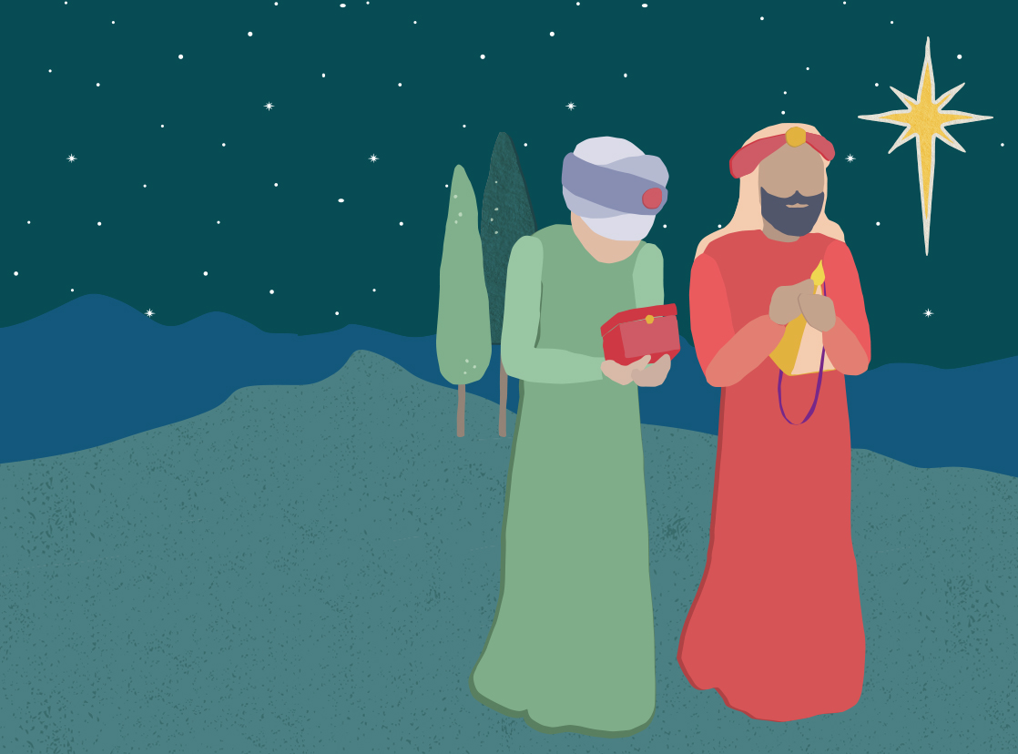
Week Four: A Week of Love
Lord Our God,
You are the source of all.
Accompany us this Advent as we prepare for the coming of Jesus. Guide us and lead us Lord as we use our gifts of goodness to work as one to create the world you want.
Awake in my heart hope, peace, love and joy this Advent.
We ask this prayer in Your name,
Amen.
Notes:
Notes for Teachers:
It is recommended that the Word is read directly from the Bible.
A copy of the scriptural text is included below for your reference taken from
Lk 1:39-45
A reading from the holy Gospel according to Luke
Mary set out and went as quickly as she could to a town in the hill country of Judah. She went into Zechariah’s house and greeted Elizabeth. Now as soon as Elizabeth heard Mary’s greeting, the child leapt in her womb and Elizabeth was filled with the Holy Spirit. She gave a loud cry and said, ‘Of all women you are the most blessed, and blessed is the fruit of your womb. Why should I be honoured with a visit from the mother of my Lord? For the moment your greeting reached my ears, the child in my womb leapt for joy. Yes, blessed is she who believed that the promise made her by the Lord would be fulfilled.’

Slide 32
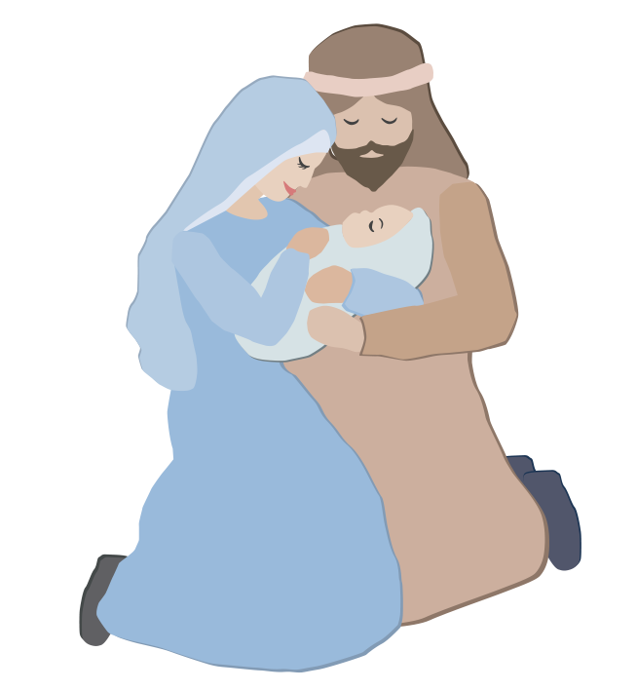
Week Four: A Week of Love
A reading from the holy Gospel according to Luke1:39-45
Mary set out and went as quickly as she could to a town in the hill country of Judah. She went into Zechariah’s house and greeted Elizabeth. Now as soon as Elizabeth heard Mary’s greeting, the child leapt in her womb and Elizabeth was filled with the Holy Spirit. She gave a loud cry and said, ‘Of all women you are the most blessed, and blessed is the fruit of your womb. Why should I be honoured with a visit from the mother of my Lord? For the moment your greeting reached my ears, the child in my womb leapt for joy. Yes, blessed is she who believed that the promise made her by the Lord would be fulfilled.’
Reflection Questions
What does Mary’s yes tell us of her faith and belief in God?
How might you respond if asked to show complete faith in God?
Elizabeth thought she would never have a baby. Why is it important that we keep faith in God?
Do others recognise the spirit of God in you?
Do you recognise the spirit of the Lord in yourself?
When do you see the spirit of the Lord in others?
What do you think God has in his plan for us?
^{giftofgoodness.org}
Notes:
Notes for Teachers:
It is recommended that the Word is read directly from the Bible.
A copy of the scriptural text is included below for your reference taken from
Lk 1:39-45
A reading from the holy Gospel according to Luke
Mary set out and went as quickly as she could to a town in the hill country of Judah. She went into Zechariah’s house and greeted Elizabeth. Now as soon as Elizabeth heard Mary’s greeting, the child leapt in her womb and Elizabeth was filled with the Holy Spirit. She gave a loud cry and said, ‘Of all women you are the most blessed, and blessed is the fruit of your womb. Why should I be honoured with a visit from the mother of my Lord? For the moment your greeting reached my ears, the child in my womb leapt for joy. Yes, blessed is she who believed that the promise made her by the Lord would be fulfilled.’

Slide 33
Rebecca: An Act of Love
When crisis or disadvantage enters people’s lives they often don’t know how to make a start with solving their problems. CatholicCare runs a service available free to all called CCareline. One counsellor, Rebecca, wrote how working at CCareline is an act of love.
“Every day I do my best to give people hope that things will be OK. Sometimes people call when they are lonely and need a chat. I find that there are many elderly people in our community who are isolated in their homes, and they need someone to talk through their worries with.
Often people will call when they are at crisis point. Not long ago we received a phone call from a school principal who wanted to help a family but didn’t know what to do. There were four kids in the family, aged 5, 7, 10 and 13. The family had moved to Australia from overseas and they didn’t have any local friends or family to help them out. The five and seven-year-old were having troubles at school, and the mother was very worried about them. The family was also at risk of losing their home because they could not afford to pay rent. Once the principal got in touch with us we were able to link the family in with services to help them get back on their feet. We made sure that the family had somewhere safe and secure to live, and that the children could focus at school without worrying about issues at home.”
The CCareline team also visits elderly people needing assistance in their homes to tailor services to their unique needs, providing a single contact from first telephone call until services are established.
The team at CCareline have the best job in the world… they get to help people who are looking for help. Giving people the help they need is an act of love.
^{giftofgoodness.org}
Notes:
Source story:
Teachers may add in more confronting details or remove as they see fit.
CatholicCare runs a service available free to all called CCareline. When crisis or disadvantage enters people’s lives they often don’t know how to make a start with solving their problems. The team at CCareline have the best job in the world… they get to help people who are looking for help. Giving people the help they need is an act of love.
One of our counsellors, Rebecca, wrote this beautiful story about how working at CCareline is an act of love.
Every day I do my best to give people hope that things will be OK. Sometimes people call when they are lonely and need a chat. I find that there are many elderly people in our community who are isolated in their homes, and they need someone to talk through their worries with.
Often people will call when they are at crisis point. Not long ago we received a phone call from a school principal who wanted to help a family but didn’t know what to do. There were four kids in the family, aged 5, 7, 10 and 13. The family had moved to Australia from overseas and they didn’t have any local friends or family to help them out. The five and seven-year-old were having troubles at school, and the mother was very worried about them. The family was also at risk of losing their home because they could not afford to pay rent. Once the principal got in touch with us we were able to link the family in with services to help them get back on their feet. We made sure that the family had somewhere safe and secure to live, and that the children could focus at school without worrying about issues at home.
It is always nice to hear that a caller has found CCareline helpful. Recently, a caller wrote to us saying:
“This was such a helpful phone call. You have really listened to me. It is very reassuring to know you can get help and support when there are big things happening in your life. I am feeling so much better than when I first called.”

Slide 34
Reflection
Rebecca shows love by listening and helping others. How do you show God’s love to others?
What have you done to share the spirit of Advent with others this year?
How can you open your heart to receiving God’s love this Advent?
How can I show love to my neighbours this Advent?
Were you aware of CatholicCare and the important work they are doing in our city? How can you help spread their good news to others?
What are you most proud of this Advent?
How does my support of the Gifts of Goodness campaign make a difference in the lives of others?
^{giftofgoodness.org}

Slide 35
See, Judge, Act
See
What exactly is happening?
What is it doing to the people?
Why is this happening?
Judge
What do you think about all this?
What do you think should be happening?
What does your faith say?
Act
What exactly is it that you want to change?
What actions are you going to take now?
Who can you involve in your action?
^{giftofgoodness.org}
Notes:
Notes for Teachers:
It is recommended that the Word is read directly from the Bible.
A copy of the scriptural text is included below for your reference taken from
Lk 1:39-45
A reading from the holy Gospel according to Luke
Mary set out and went as quickly as she could to a town in the hill country of Judah. She went into Zechariah’s house and greeted Elizabeth. Now as soon as Elizabeth heard Mary’s greeting, the child leapt in her womb and Elizabeth was filled with the Holy Spirit. She gave a loud cry and said, ‘Of all women you are the most blessed, and blessed is the fruit of your womb. Why should I be honoured with a visit from the mother of my Lord? For the moment your greeting reached my ears, the child in my womb leapt for joy. Yes, blessed is she who believed that the promise made her by the Lord would be fulfilled.’

Slide 36
See, Judge, Act Based upon the Cardijn Method
See What exactly is happening? What is it doing to the people? Why is this happening?
Judge What do you think about all this? What do you think should be happening? What does your faith say?
^{giftofgoodness.org}

Slide 37
See, Judge, Act Based upon the Cardijn Method
Act What exactly is it that you want to change? What actions are you going to take now? Who can you involve in your action?
^{giftofgoodness.org}

